Slide 1

Today’s Agenda
D-Latch
D-Flip Flops

Slide 2
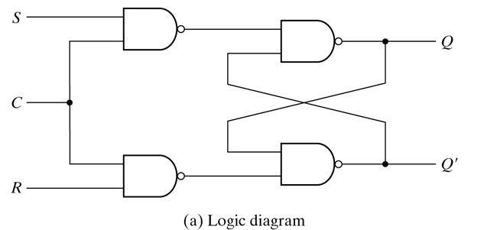
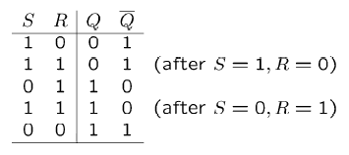
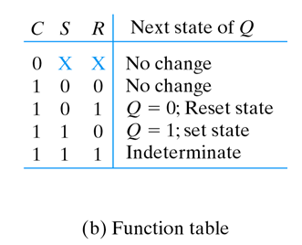
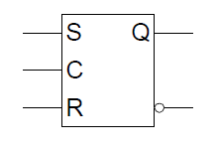
S-R Latch with control input

Slide 3
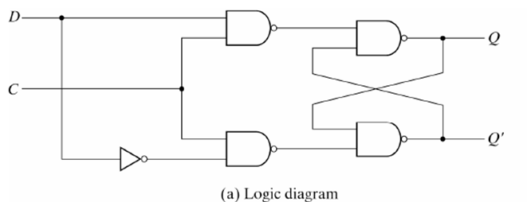
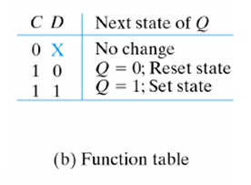
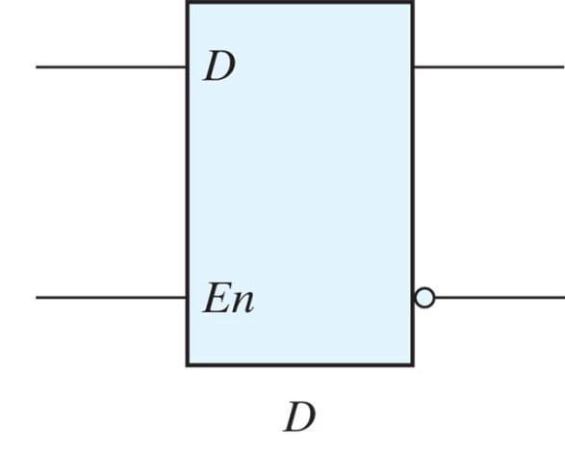
D-Latch

Slide 4
D Latch (D – Data)
Timing Diagram
C
D
C D | Q
0 x | Q₀
1 0 | 0
1 1 | 1
Q
No change
Reset
Set
t
Output may change
Sensitive to levels
Level triggered
C

Slide 5

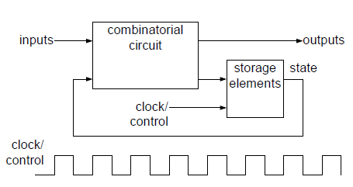
Problem With Latch

Slide 6

Master-Slave D Flip Flop
Consider two latches combined together
Only one C value active at a time
D Latch
(Master)
D Latch
(Slave)
D
D
C
Q
D
C
Q
Q
CLK

Slide 7
D Flip-Flop
  When the output of F/F will change? When CLK will be??
D Latch
(Master)
D Latch
(Slave)
D
D
C
Q
D
C
Q
Q
CLK
Master
Slave
Looks like it is negative edge-triggered
CLK
D
  i.e. a change in the output of the flip-flop can be triggered only by and during the transition of the clock from 1 to 0
Q_{Master}
Q_{Slave}
Notes:
Note the layout here.
The flip-flop input D is connected directly to the master latch.
The master latch output goes to the slave.
The flip-flop outputs come directly from the slave latch.

Slide 8
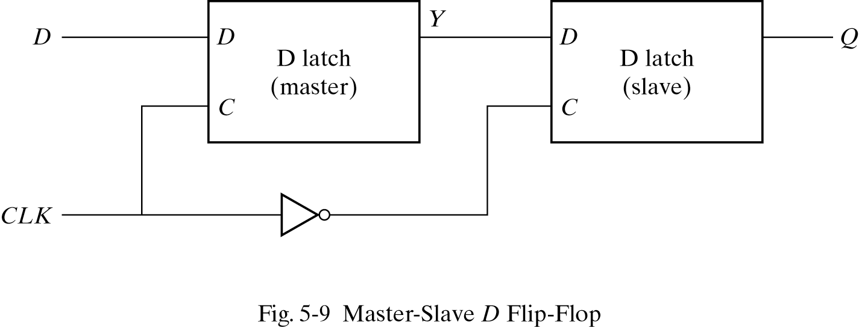

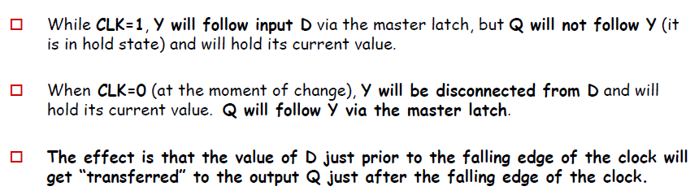
Master-Slave D Flip Flop

Slide 9
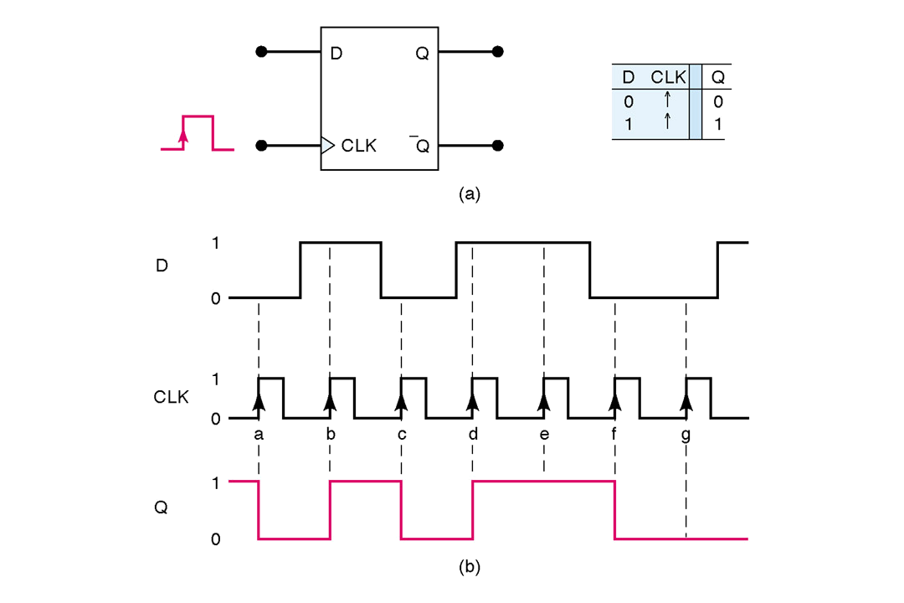
Timing Diagram of D Flip-Flop
Stores a value on the positive edge of C
Input changes at other times have no effect on output

Slide 10
Graphical Representations of DFF
D
Q
D
Q
Q
Q
Negative Edge
Positive Edge

Slide 11
Characteristic Table and Equation of D Flip Flop
Positive edge triggered
D C Q(t+1) Q’(t+1)
D
Q
0 0 1
1 1 0
Reset
Set
C
Q’
X 0
Q(t) Q’(t)
Characteristic Equation
Q(t+1)= D

Slide 12
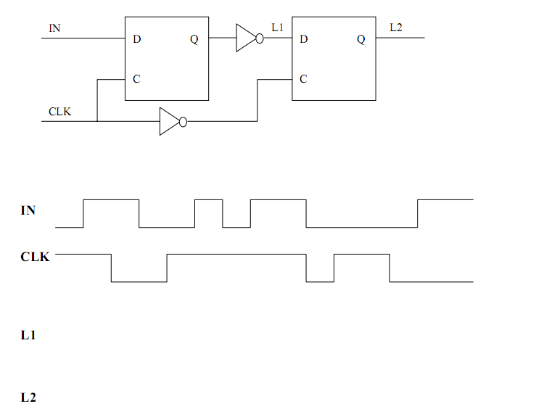
Practice Problem
Analyze the following circuit by showing the values at nodes L1 and L2 at each step. Assume both latches are initially outputting zero. The boxes are D latches.

